Slide 1

Legal AI Navigator
Enterprise Multi-Agent Classification Pipeline
CAPSTONE IMPLEMENTATION 2026
Maharth Thakar

Slide 2
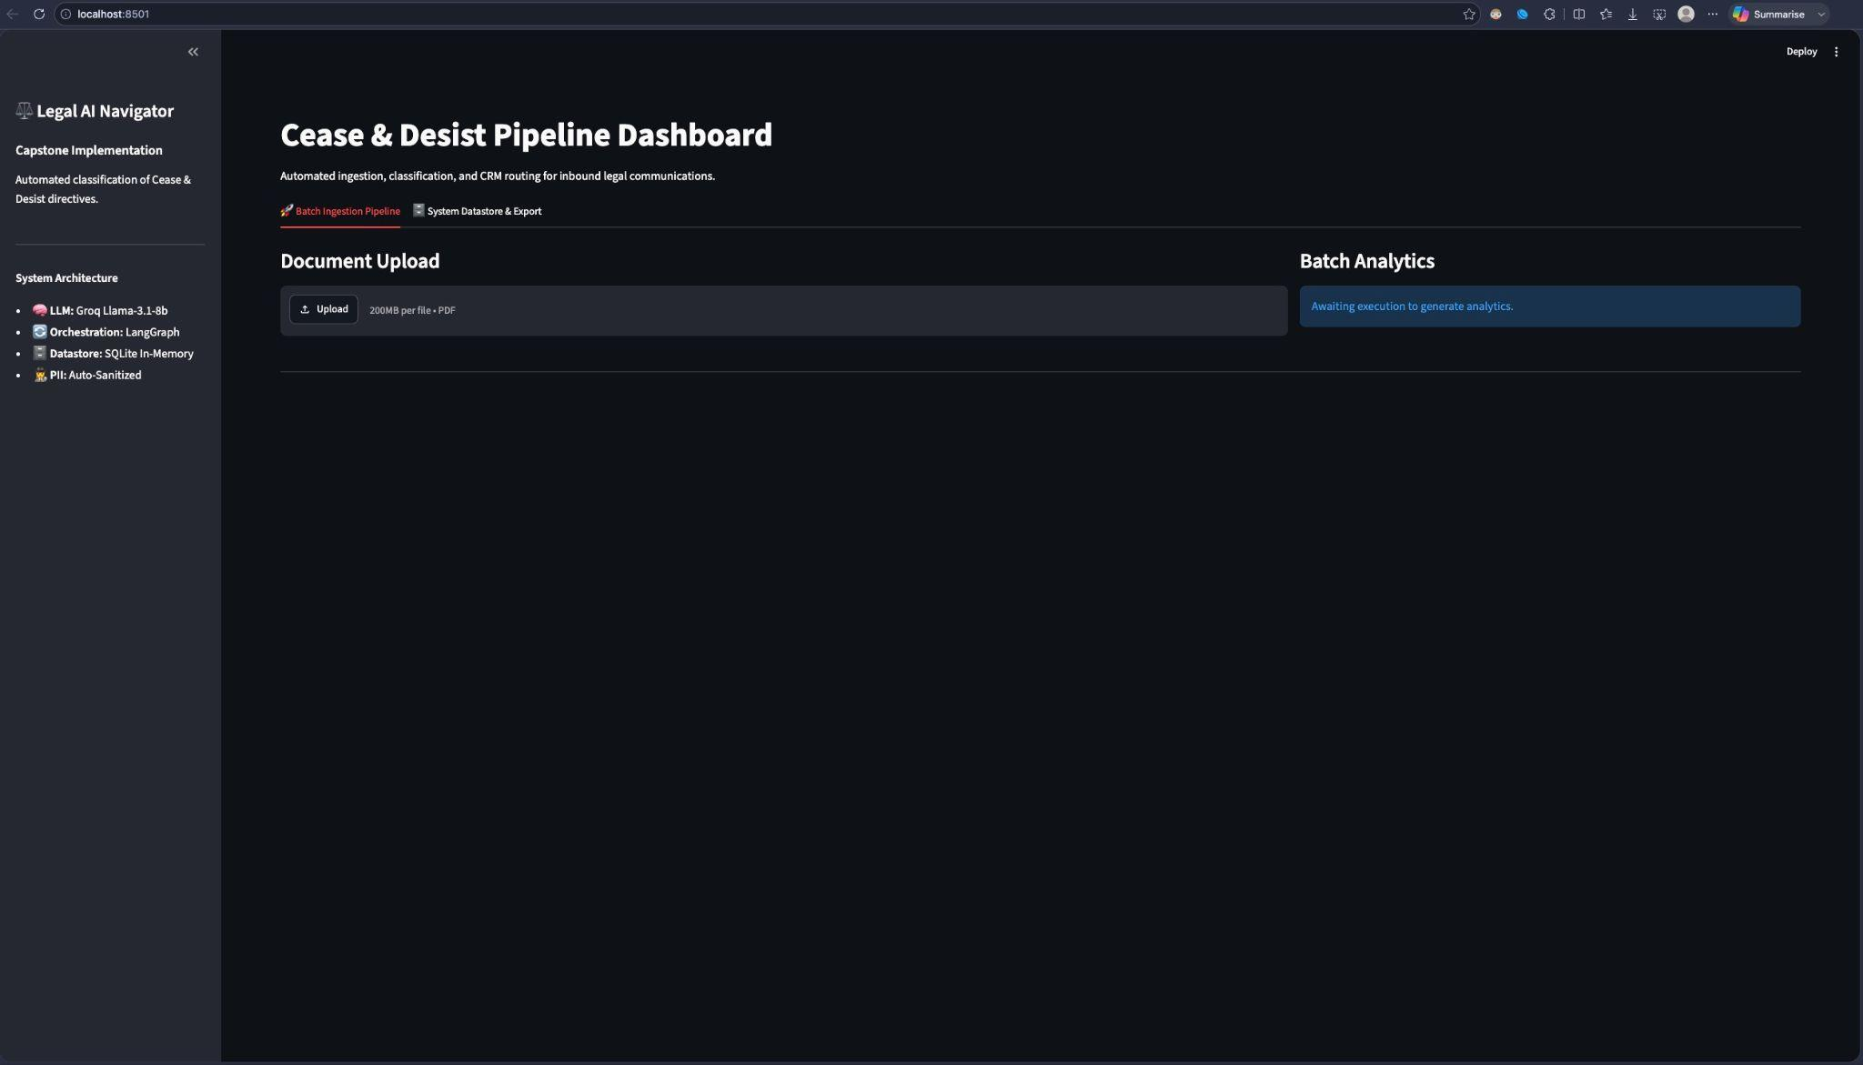

Unified Command Center
Centralized Ingestion
The Legal AI Navigator replaces scattered manual reviews with a unified, dark-mode enterprise dashboard.
Built on Streamlit for instant deployment.
Seamless interface for legal ops.
Direct integration with underlying LangGraph logic.

Slide 3
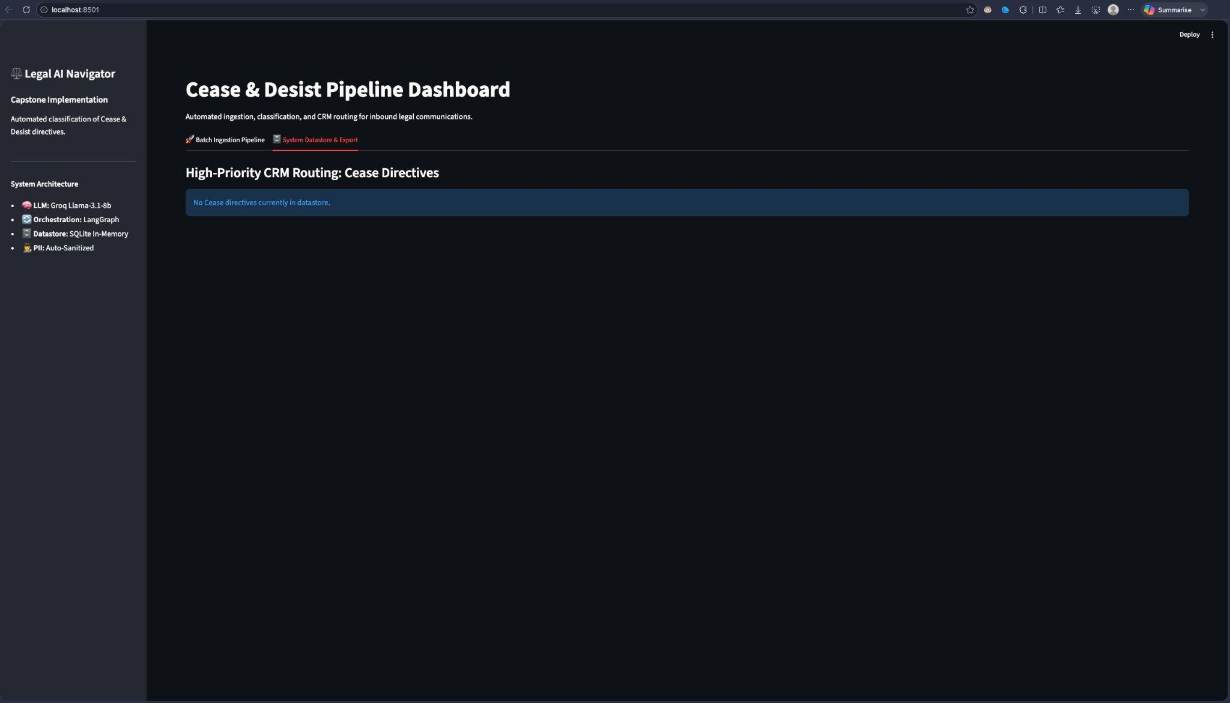
Batch Intake
Handling Enterprise Scale
Users can drag and drop massive quantities of unsorted legal PDFs directly into the ingestion zone.
Immediate staging of 19+ documents.
One-click pipeline execution.
Pre-loads metadata into system memory.

Slide 4
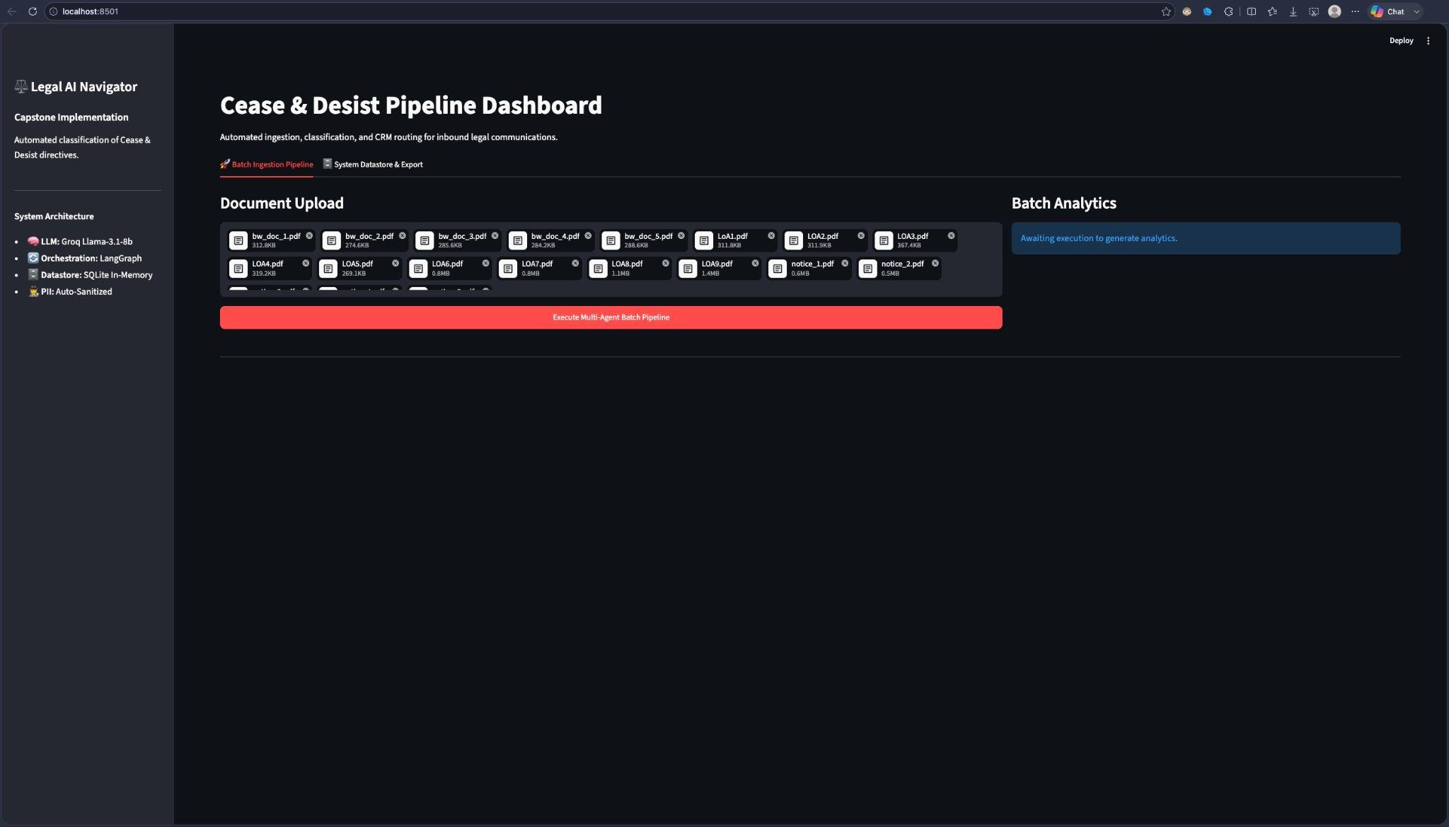
Live Orchestration
Transparent Processing
As the LangGraph nodes spin up, the UI provides real-time feedback, eliminating the "black box" anxiety typical in AI products.
Dynamic progress tracking.
Live status updates (Analyzing: bw_doc_1...).
Asynchronous API calls to Llama-3.1.

Slide 5
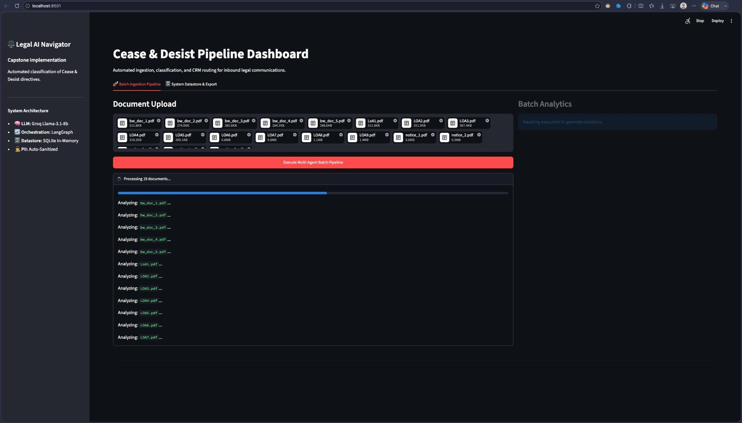

Slide 6




Instant KPI Insights
Quantifiable Triage
Upon completion, the dashboard immediately calculates the batch distribution, highlighting critical enterprise risks.
19
9
6
4

Slide 7
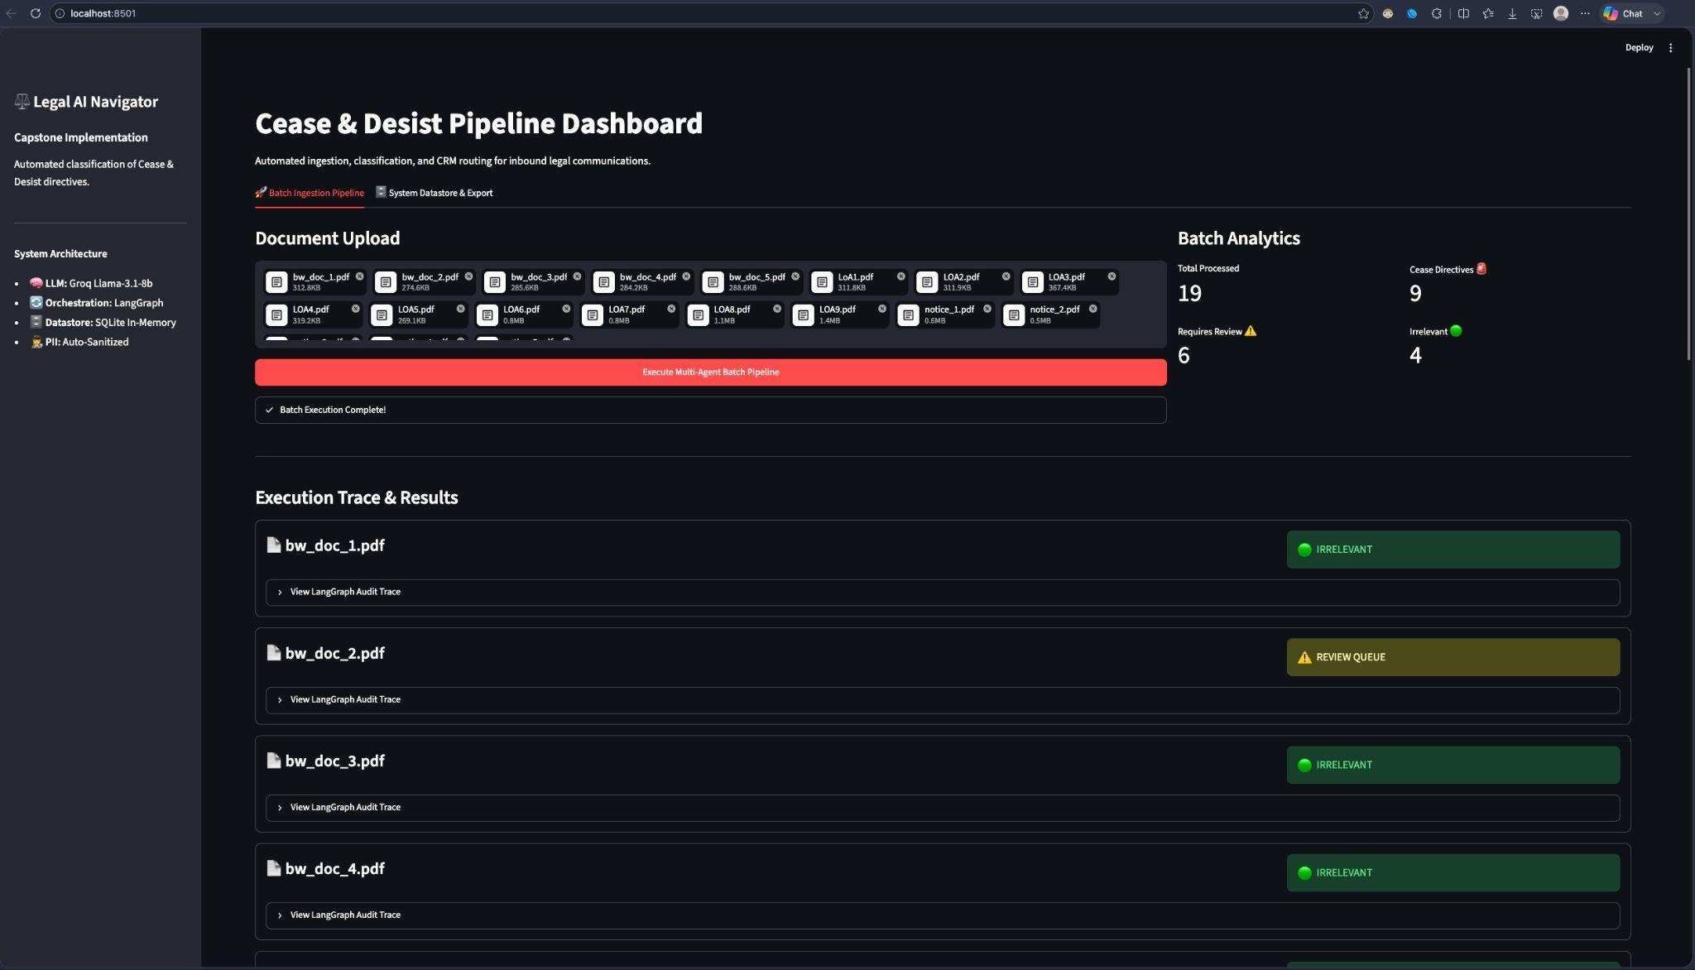

Slide 8
Visual Triage Cards
Color-Coded Routing
Documents are transformed into actionable result cards, visually separated by their LangGraph classification.
The system clearly delineates between Irrelevant documents, Review Queue anomalies, and critical Cease Directives.

Slide 9
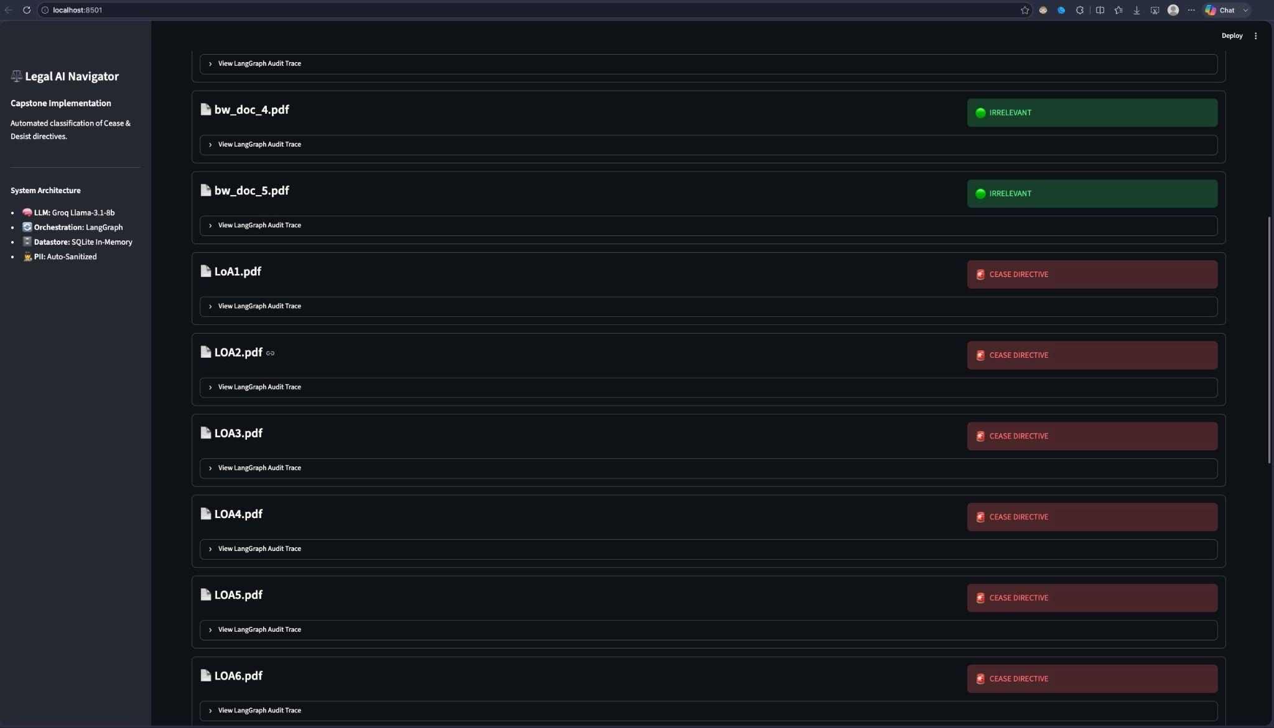

Slide 10
Algorithmic Auditability
Step-by-Step Transparency
Every single result can be expanded to reveal the exact logic pathway taken by the multi-agent system.
Timestamps for OCR & Sanitization.
LLM Confidence Scores rendered in UI.
Algorithmic verification status.

Slide 11
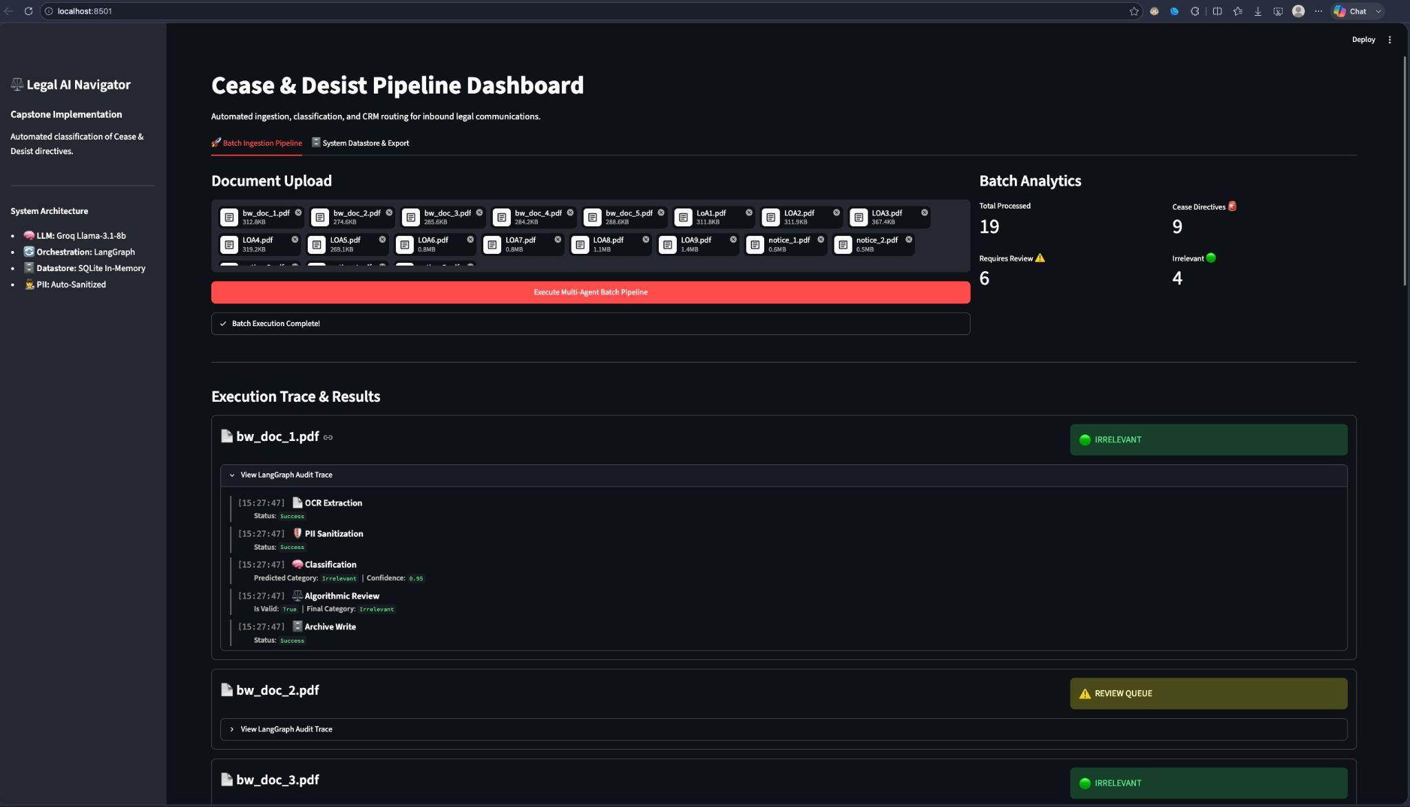

Slide 12
CRM-Ready Datastore
High-Priority Routing
Only the documents flagged as Cease Directives are persisted to the secure SQLite Datastore.
This filters out the noise of irrelevant notices and allows legal operations teams to immediately export the 9 critical directives via CSV to external systems like Salesforce or ServiceNow.

Slide 13
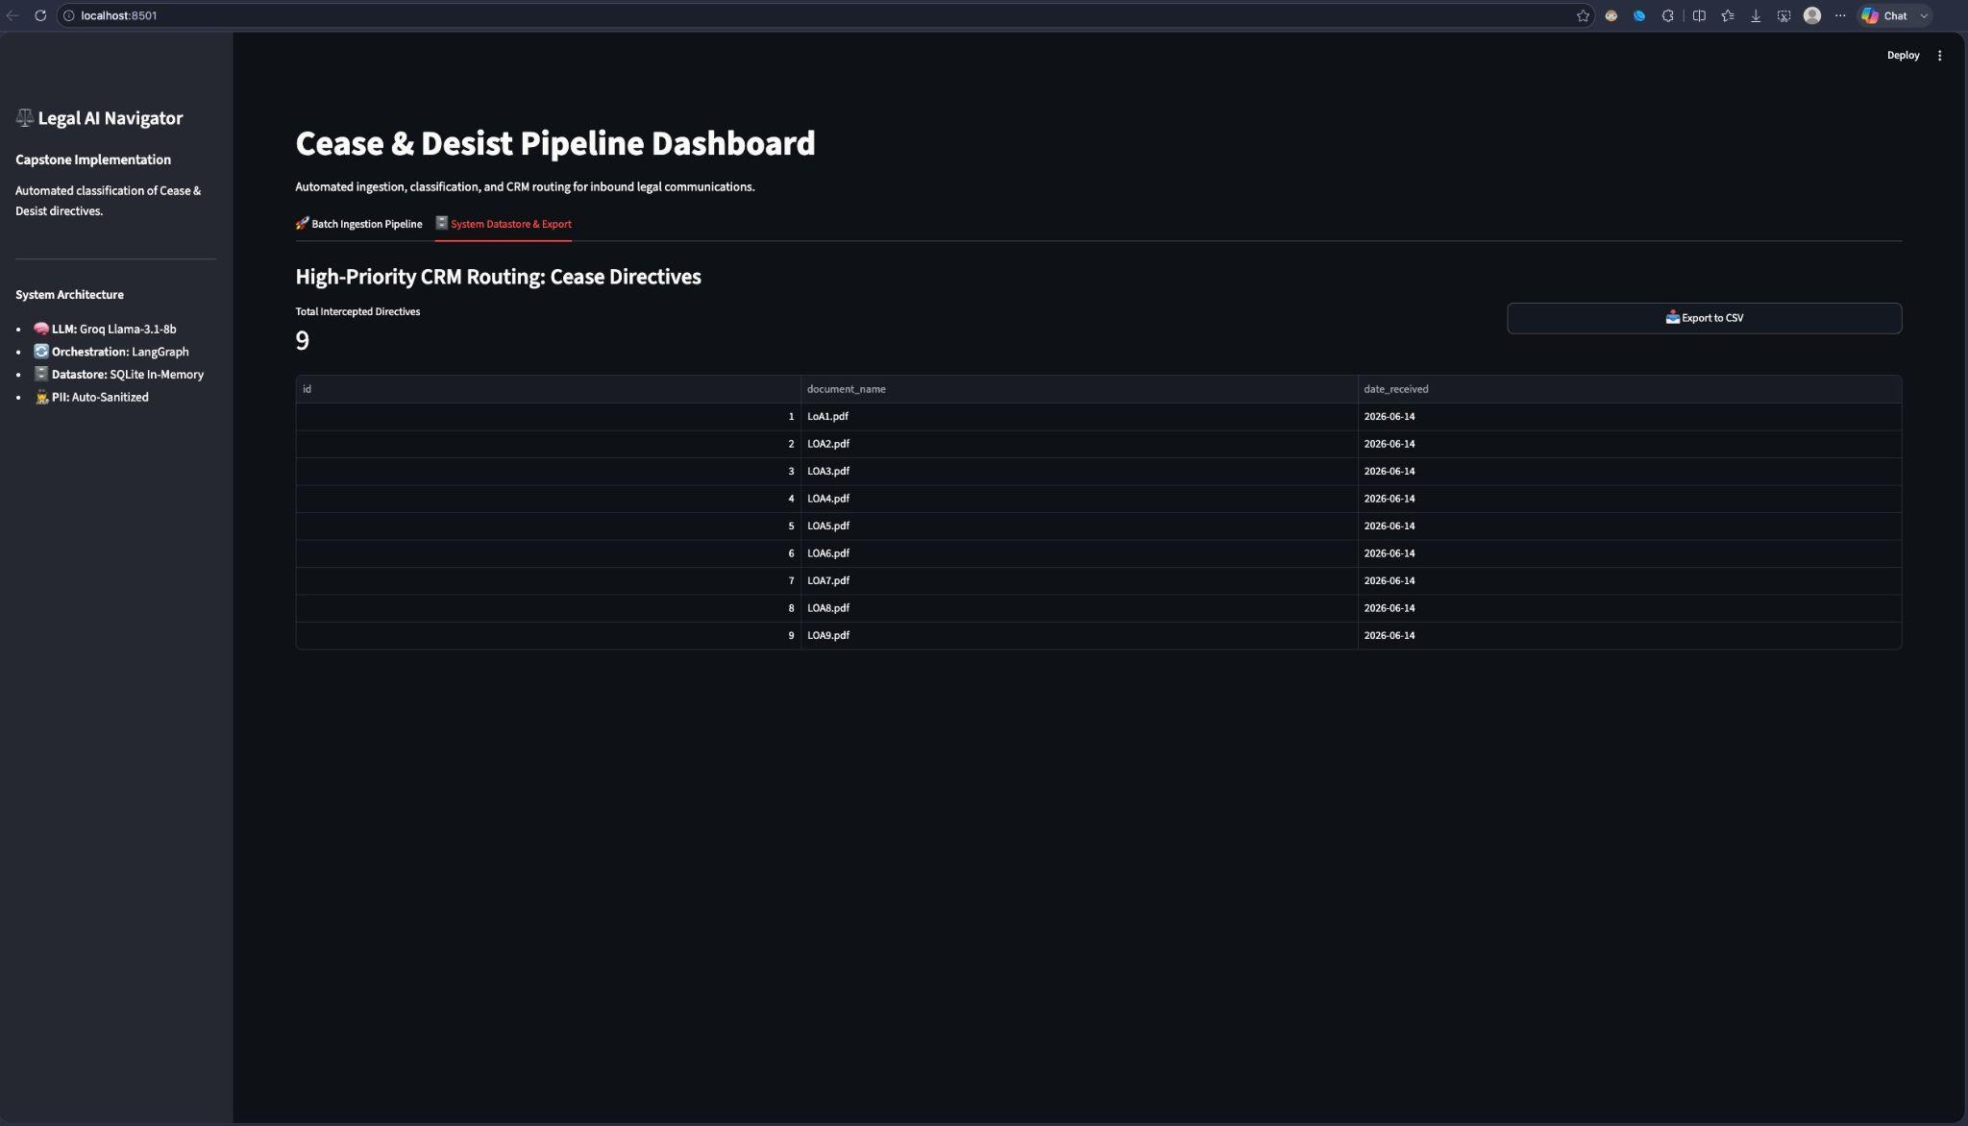

Slide 14
Thank you for reviewing the Legal AI Navigator Pipeline.
https://github.com/maharththakar/Capstone-Project

